Slide 1


Morphological Operation Department of Electronics and Electrical Communication Engineering Indian Institute of Technology, Kharagpur

Slide 2
Morphological Operation
Local pixel transformations.
Set Operation, Logical transformations
Application :
Smooth region boundaries for shape analysis.
Remove noise and artefacts from an imperfect segmentation.
Match particular pixel configurations in an image for simple object recognition.

Slide 3

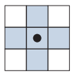
Preliminaries
In binary images, the sets in question are members of the 2-D integer space Z²
Structuring element (B)
Image is from: Digital Image processing by Gonzalez and Woods

Slide 4
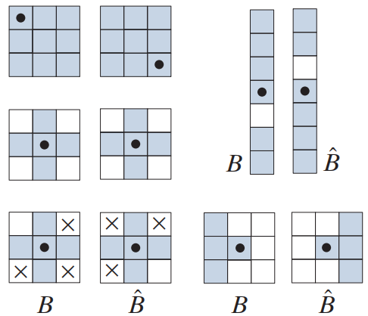
Preliminaries
Reflection
In Z², the set of points in B whose (x, y) coordinates have been replaced by ( -x,-y)
Translation
In Z², the set of pixels in B whose (x, y) coordinates have been replaced by (x+z₁, y+z₂) where z={z_{1,} z₂}
Image is from: Digital Image processing by Gonzalez and Woods

Slide 5
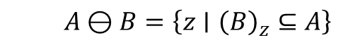
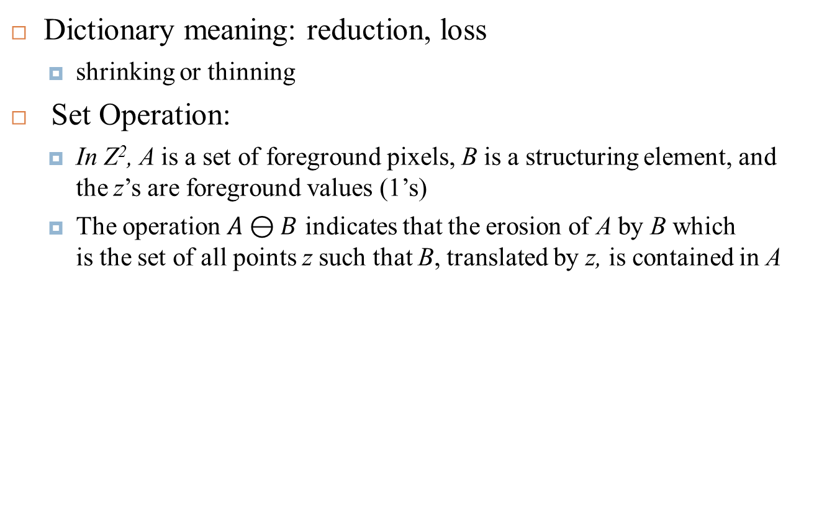
Erosion
Dictionary meaning: reduction, loss
shrinking or thinning
Set Operation:
In Z², A is a set of foreground pixels, B is a structuring element, and the z’s are foreground values (1’s)
The operation $A⊖B$ indicates that the erosion of A by B which is the set of all points z such that B, translated by z, is contained in A
$$A⊖B=\left\{z∣{\left(B\right)}_{z}⊆A\right\}$$

Slide 6
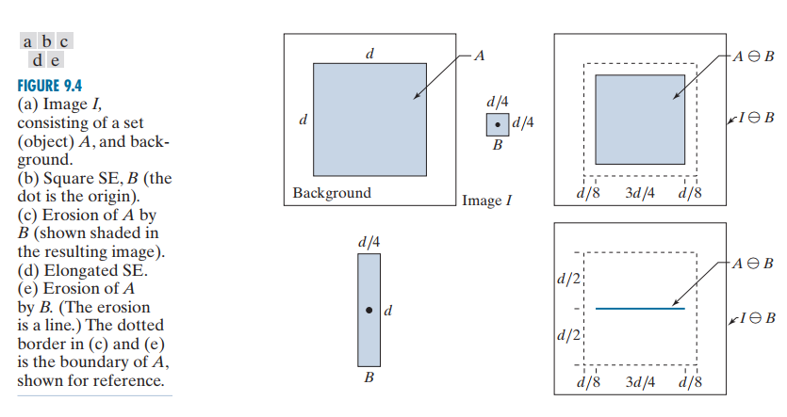
Erosion
Image is from: Digital Image processing by Gonzalez and Woods

Slide 7
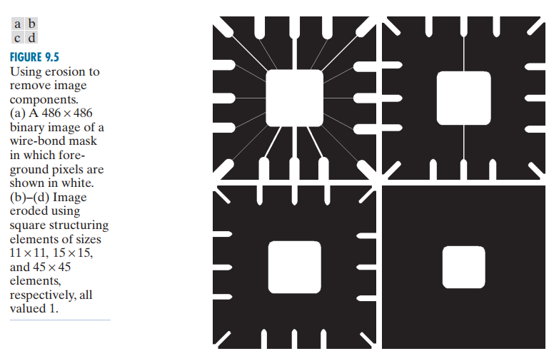
Erosion
Image is from: Digital Image processing by Gonzalez and Woods

Slide 8
Dilation
Dictionary meaning: enlargement, stretching, or expansion
grows or thickens
Set Operation:
In Z^{2,} A is a set of foreground pixels, B is a structuring element, and the z’s are foreground values (1’s)
is based on reflecting B about its origin and translating the reflection by z.
The dilation of A by B then is the set of all displacements, z, such that the foreground elements of overlap at least one element of A
Image is from: Digital Image processing by Gonzalez and Woods

Slide 9
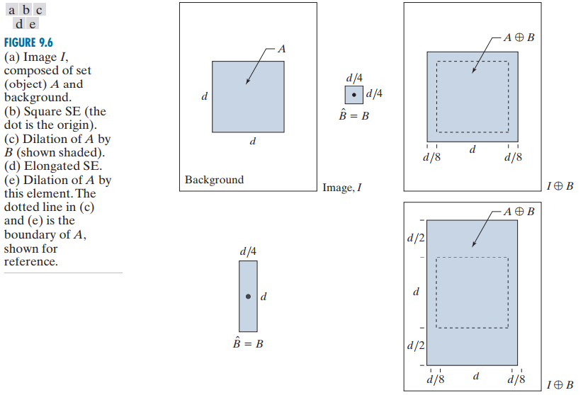
Dilation
Image is from: Digital Image processing by Gonzalez and Woods

Slide 10
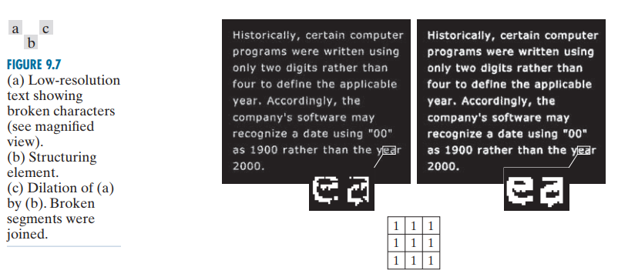
Dilation
Image is from: Digital Image processing by Gonzalez and Woods

Slide 11
Dual Operation
Erosion and dilation are duals of each other with respect to set complementation and reflection. That is, n
Image is from: Digital Image processing by Gonzalez and Woods

Slide 12
Opening and Closing
Opening:
erosion of A by B, followed by a dilation
Closing:
dilation of A by B, followed by a erosion
Opening removes (opens) small objects
Closing fills (closes) small holes

Slide 13
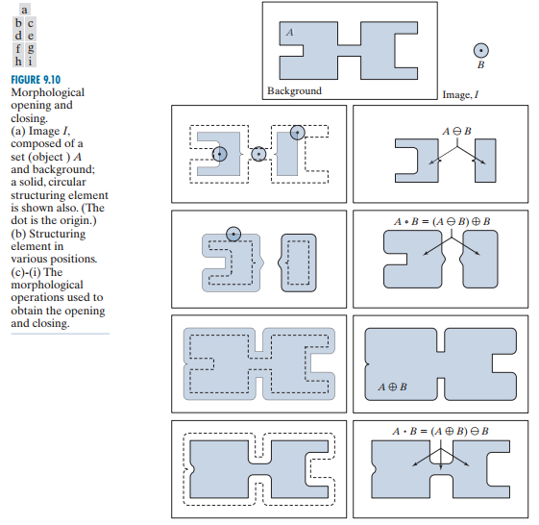
Opening and Closing
Image is from: Digital Image processing by Gonzalez and Woods

Slide 14
14
Thank You

